Slide 1
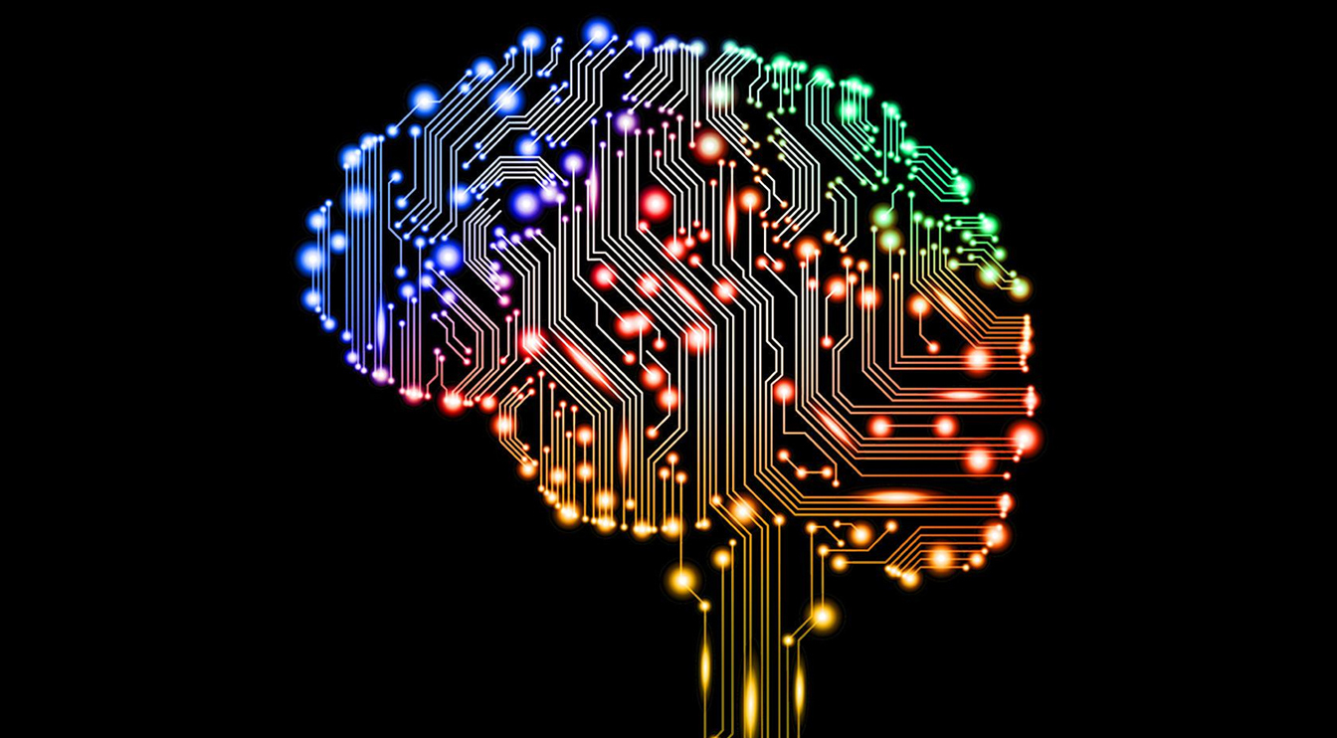
What is AI and How to Use It
WSCUG Presentation
October 9, 2023

Slide 2
What is AI?
According to ChatGPT
AI stands for "Artificial Intelligence." It is a branch of computer science that deals with the development of intelligent machines that can perform tasks that would typically require human intelligence. AI aims to create computer systems capable of learning, reasoning, and problem-solving.
AI can be categorized into two types: Narrow AI and General AI. Narrow AI, also known as Weak AI, refers to AI systems that are designed to perform specific tasks, such as voice recognition, image classification, or playing chess. These systems are specialized in a particular area and lack the ability to generalize beyond their specific domain.
On the other hand, General AI, also known as Strong AI or AGI (Artificial General Intelligence), refers to AI systems that possess the ability to understand, learn, and apply knowledge across various domains, similar to human intelligence. General AI can perform any intellectual task that a human can do, making it capable of reasoning, understanding natural language, and adapting to new situations.
AI utilizes several techniques and methodologies to achieve its objectives. Some common approaches include machine learning, which involves training algorithms on large datasets to learn patterns and make predictions, and deep learning, a subset of machine learning that uses artificial neural networks to mimic the structure and function of the human brain.
Notes:
We are just beginning to use AI. It isn’t always accurate. They have "hallucinations”. Large language models Deep Mind announced it has successfully used artificial intelligence to predict the 3D structures of nearly every catalogued protein known to science. That's over 200 million proteins

Slide 3
What is AI?
According to Bing Chat
Artificial Intelligence (AI) is the simulation of human intelligence processes by computer systems. These processes include learning, reasoning, and self-correction. AI is used in a variety of applications such as natural language processing, speech recognition, image recognition, and decision-making. AI is also used in robotics to enable machines to perform tasks that would otherwise require human intervention. AI has the potential to revolutionize many industries and improve our daily lives in many ways.

Slide 4
What Can it be Used For?
AI can provide various benefits and services to end users. Here are some ways AI can enhance the user experience:
Personalized Recommendations: AI algorithms can analyze user preferences, behavior, and historical data to provide personalized recommendations for products, services, movies, music, and more. This helps users discover new things tailored to their individual tastes.
Virtual Assistants: AI-powered virtual assistants, such as Siri, Alexa, and Google Assistant, can help users with tasks like setting reminders, making reservations, searching the web, and controlling smart home devices. These assistants use natural language processing and machine learning to understand and respond to user commands.
Customer Service: AI chatbots and virtual agents are increasingly being used to provide customer support and handle inquiries. They can provide instant responses to common questions, offer troubleshooting assistance, and escalate complex issues to human agents when necessary.
Source ChatGPT

Slide 5
What Can it be Used For?
Smart Home Automation: AI can enable users to control various aspects of their homes through voice commands or smartphone apps. AI-powered systems can adjust temperature settings, turn on lights, manage security systems, and even learn user preferences to automate daily routines.
Healthcare Support: AI can assist users in monitoring their health, providing insights, and offering personalized recommendations. For example, wearable devices with AI capabilities can track physical activity, sleep patterns, and heart rate to provide users with feedback and suggestions for improving their well-being.
Content Creation: AI can help users generate content, such as automated transcription services, language translation, and even creative writing assistance. These tools can save time and provide valuable support to users in various professional and creative fields
Source ChatGPT

Slide 6
What Can it be Used For?
Image and Video Recognition: AI algorithms can analyze and categorize visual content. This technology is used in applications like facial recognition for unlocking devices, automatic photo tagging, content moderation, and object recognition in augmented reality (AR) experiences.
Financial Services: AI can be utilized in various financial applications, such as fraud detection, credit scoring, and personalized financial planning. AI-powered chatbots can also provide users with real-time financial information and assistance in managing their finances.
Education and Learning: AI-based learning platforms can personalize educational content and adapt to individual student needs. AI tutors can provide personalized feedback, suggest additional resources, and adapt the learning pace to optimize the educational experience.
Travel Assistance: AI-powered travel platforms can help users plan trips, find the best deals, suggest itineraries, and provide real-time updates on flight statuses and weather conditions. AI can also assist with language translation and navigation in unfamiliar locations.
These are just a few examples of how AI can benefit end users across various domains. AI's ability to process vast amounts of data, make predictions, and learn from user interactions enables it to provide personalized and valuable services to individuals.
Source ChatGPT

Slide 7
What Bing Chatbot Says It Can Be Used For
Bing Chatbot has several features that can be helpful. Some of these features include creating comparison tables, performing multi-step web searches, drawing text art, converting dates and times, turning web pages into quizzes, and getting up-to-date information on current events. Bing Chatbot can also provide you with information and insights on the website currently open in the browser. Recently, Microsoft has added new features to Bing Chatbot such as image and video answers, restaurant bookings, chat history, and some smarter Microsoft Edge integration
Source Bing

Slide 8
What are Some Risks with AI
Bias and Fairness: AI systems can inherit biases from the data they are trained on, which can lead to unfair and discriminatory outcomes. This bias can be especially problematic in areas like hiring, lending, and criminal justice.
Privacy Concerns: AI systems often require large amounts of data to function effectively. Collecting and handling personal data can raise concerns about privacy and data security, especially when it is used without the informed consent of individuals.
Job Displacement: Automation driven by AI and robotics has the potential to replace certain jobs, particularly those that involve repetitive tasks. This can lead to job displacement and economic disruptions in some industries.
Ethical Concerns: As AI becomes more sophisticated, ethical questions arise regarding its use in sensitive areas such as healthcare, autonomous weapons, and surveillance. Decisions made by AI systems can have profound ethical implications.

Slide 9
AI Risks
Security Risks: AI can be vulnerable to attacks and manipulation. Adversarial attacks can deceive AI systems, and the use of AI in cyberattacks can make threats more sophisticated and harder to defend against.
Lack of Accountability: When AI systems make mistakes or cause harm, it can be challenging to determine who is responsible. This lack of accountability raises legal and ethical questions.
Loss of Control: As AI systems become more autonomous, there is a risk of losing control over them. This is a concern in applications like self-driving cars and military drones.
Data Dependency: AI systems rely on high-quality and diverse data for training and decision-making. If the data is incomplete, biased, or outdated, it can lead to inaccurate and unreliable results.
Transparency and Explainability: Many AI algorithms, such as deep neural networks, are often seen as "black boxes" because it can be challenging to understand how they arrive at their decisions. Lack of transparency can hinder trust and accountability.
Social Manipulation: AI can be used to create deepfake content, generate misinformation, and manipulate public opinion on a massive scale, posing risks to political and social stability.

Slide 10
AI Risks
Regulatory Challenges: Policymakers and regulators face challenges in keeping up with the rapid pace of AI development. Establishing effective regulations that balance innovation and safety is a complex task.
Economic Inequality: The benefits of AI are not evenly distributed, and there is a risk of exacerbating economic inequality if access to AI technology and its benefits is not equitable.
Source ChatGPT
Notes:
Hallucinations, lawyer

Slide 11
Companies Providing End User AI Products
As of my knowledge cutoff in September 2021, there are several prominent companies that provide consumer AI products and services. However, please note that the landscape of consumer AI is constantly evolving, and new companies may have emerged since then. Here are some well-known companies in the consumer AI space:
Google: Google offers various AI-powered products and services, including Google Assistant (voice-activated virtual assistant), Google Photos (with automatic image recognition and organization), and Google Translate (language translation).
Amazon: Amazon has integrated AI into many of its consumer offerings. The most notable example is Amazon Alexa, the virtual assistant used in devices like the Amazon Echo smart speakers. Alexa can perform tasks, answer questions, and control smart home devices.
Apple: Apple incorporates AI into its products and services, such as Siri (voice assistant for iOS devices), which can perform tasks, provide information, and interact with apps. Additionally, Apple uses AI techniques for features like facial recognition in the Photos app and personalized recommendations in Apple Music.
Microsoft: Microsoft provides consumer AI through services like Cortana (voice assistant for Windows devices), which can help with tasks and provide information. Microsoft also uses AI in products like the Microsoft Office suite for features like grammar checking and intelligent data analysis.
Source ChatGPT

Slide 12
Companies Providing End User AI Products
Facebook: Facebook utilizes AI in various ways to enhance user experiences. Examples include facial recognition for photo tagging, content recommendation algorithms, and automated language translation on the platform.
NVIDIA: While primarily known for their graphics processing units (GPUs), NVIDIA is a key player in AI technology. Their GPUs are widely used for training and running deep learning models, enabling AI advancements in various consumer applications like autonomous vehicles and gaming.
IBM: IBM offers Watson, an AI platform that provides solutions for various industries, including healthcare, finance, and customer service. While primarily focused on enterprise applications, IBM Watson also has consumer-facing implementations, such as AI-powered chatbots.
Samsung: Samsung incorporates AI into its consumer electronics products, including smartphones, smart TVs, and home appliances. Their virtual assistant, Bixby, is designed to provide voice-based assistance and control over Samsung devices.
OpenAI which provides ChatGPT
Source ChatGPT

Slide 13
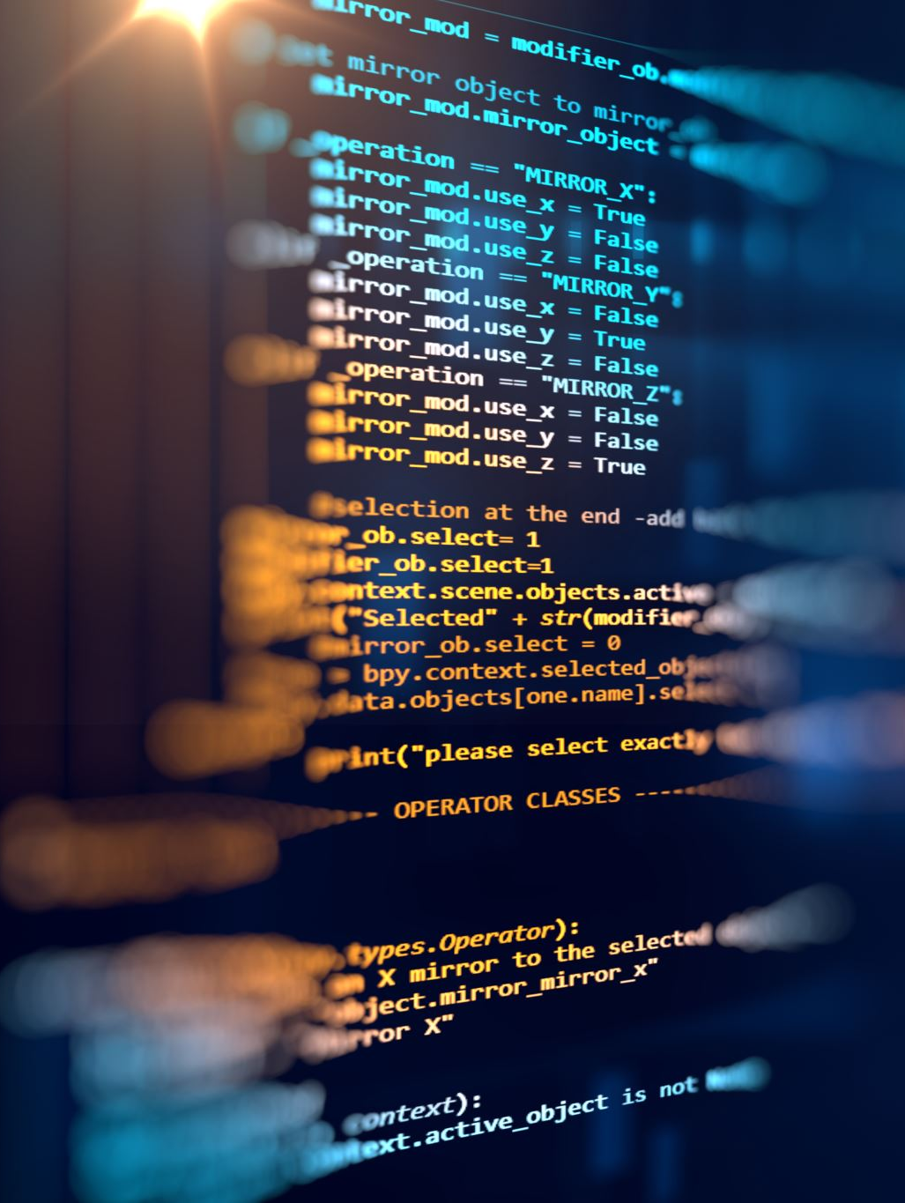
AI Software
Google Bard https://bard.google.com/
Microsoft Bing chatbox available in the Edge browser
Chat GPT https://chat.openai.com/?model=text-davinci-002-render-sha
DALL-E https://labs.openai.com/
Microsoft Bing image creator https://www.bing.com/images/create
Microsoft Designer https://designer.microsoft.com/
Microsoft Copilot will be added to Windows and Office beginning fall of 2023

Slide 14
Is it Useful?
This presentation was created in under 30 minutes almost exclusively generated by ChatGPT. Generally, a presentation like this would take 4 to 6 hours or more.
Page designs were created by the built in designer feature of PowerPoint.
Try some of the sources listed to see what you can do with AI.

