Slide 1
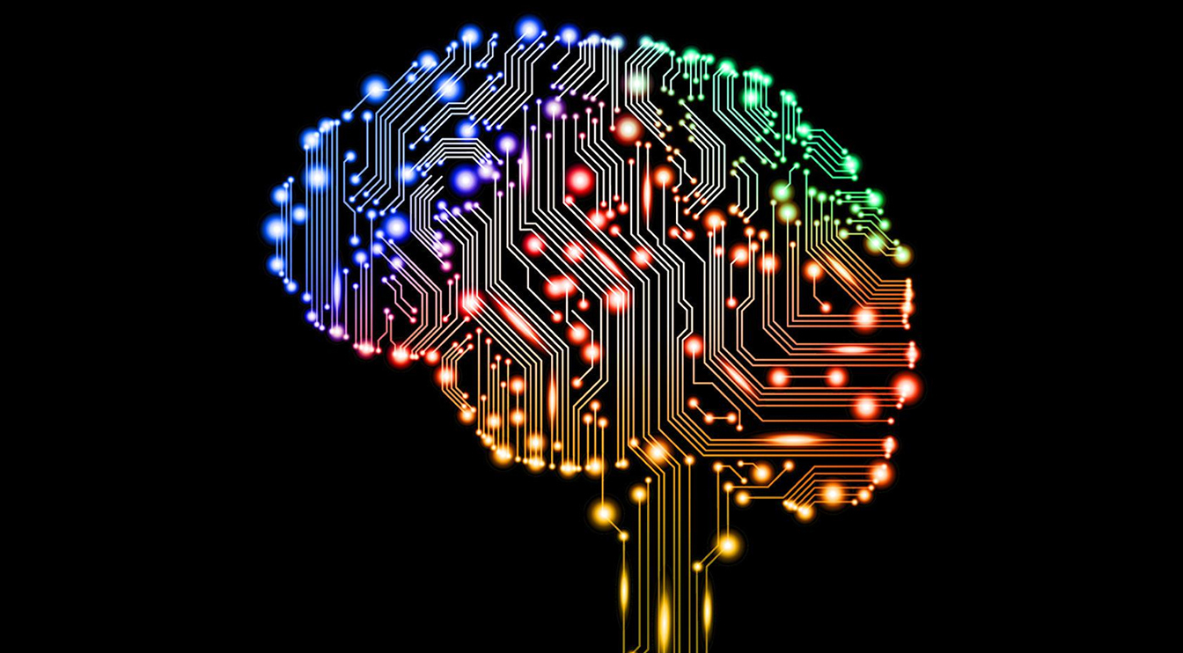
AI and You
AAUW
April 15, 2025

Slide 2
What is AI?
AI stands for "Artificial Intelligence." It is a branch of computer science that deals with the development of intelligent machines that can perform tasks that would typically require human intelligence. AI aims to create computer systems capable of learning, reasoning, and problem-solving.
AI can be categorized into two types: Narrow AI and Generative AI. Narrow AI, also known as Weak AI, refers to AI systems that are designed to perform specific tasks, such as voice recognition, image classification, or playing chess. These systems are specialized in a particular area and lack the ability to generalize beyond their specific domain.
On the other hand, Generative AI, also known as Strong AI or AGI (Artificial General Intelligence), refers to AI systems that possess the ability to understand, learn, and apply knowledge across various domains, similar to human intelligence. General AI can perform any intellectual task that a human can do, making it capable of reasoning, understanding natural language, and adapting to new situations.
AI utilizes several techniques and methodologies to achieve its objectives. Some common approaches include machine learning, which involves training algorithms on large datasets to learn patterns and make predictions, and deep learning, a subset of machine learning that uses artificial neural networks to mimic the structure and function of the human brain.
Notes:
What is AI.
You have experienced narrow AI for years. The answering system where a support line channels you to the correct department for your issue, the computers who have beaten masters at chess and go, and you no doubt remember the computer that won at jeopardy. As powerful as these systems are they were only good at doing one thing. The jeopardy computer would be worthless for developing an Alzheimer drug. If you have used Siri, Alexa or Google you have used AI.
What we are developing now is known as generative AI. This is AI that can simulate human thought processes and reason instead of just repeating facts.

Slide 3
What Can it be Used For?
AI can provide various benefits and services to end users. Here are some ways AI can enhance the user experience:
Personalized Recommendations: AI algorithms can analyze user preferences, behavior, and historical data to provide personalized recommendations for products, services, movies, music, and more. This helps users discover new things tailored to their individual tastes.
Virtual Assistants: AI-powered virtual assistants, such as Siri, Alexa, CoPilot and Google Assistant, can help users with tasks like setting reminders, making reservations, searching the web, and controlling smart home devices. These assistants use natural language processing and machine learning to understand and respond to user commands.
Customer Service: AI chatbots and virtual agents are increasingly being used to provide customer support and handle inquiries. They can provide instant responses to common questions, offer troubleshooting assistance, and escalate complex issues to human agents when necessary.
Notes:
Now we are in a new era where AI is gaining the ability to do many things. This is called generative AI, and it is appearing everywhere. You have it on your phone and computer, the new music you are offered on Spotify, the suggested books on Kindle, the ability to do major photo editing without specialized software and increasingly sophisticated “agents” to answer questions and solve problems. All of this is just the beginning, we will see more as AI continues to develop. This is done by training AI with Large Language Models. Essentially this means that the AI is tasked with learning everything it can about a specific subject or pretty much everything as needed for its purpose.

Slide 4
What Can it be Used For?
Smart Home Automation: AI can enable users to control various aspects of their homes through voice commands or smartphone apps. AI-powered systems can adjust temperature settings, turn lights on or off, manage security systems, and even learn user preferences to automate daily routines.
Healthcare Support: AI can assist users in monitoring their health, providing insights, and offering personalized recommendations. For example, wearable devices with AI capabilities can track physical activity, sleep patterns, and heart rate to provide users with feedback and suggestions for improving their well-being. Additionally, it can be used to speed the development of new drugs.
Content Creation: AI can help users generate content, such as automated transcription services, language translation, creative writing assistance and even pictures, video and music. These tools can save time and provide valuable support to users.
Notes:
Smart home automation will learn how you use your home and adjust the lights, temperature and monitor your security system.
Health monitoring will track your health and notify you if something is off. Soon it will communicate directly with your physician whenever there is a need. Smart watches and other devices can measure heart rate, blood pressure, blood sugar, sleep, loss of heartrate, and falls while your phone can detect auto accidents and call for help. At pharmaceutical companies it will allow the development of new drugs and procedures to maintain your health.
Content creation: AI can now write emails, contracts and letters. It can produce and edit pictures, create videos and music. It can summarize materials for you and translate documents, signs and speech from and to hundreds of languages. Voice recognition is now good enough that you no longer need to type (a god send for those of us who flunked typing, or keyboarding as it is now known.)

Slide 5
What Can it be Used For?
Image and Video Recognition: AI algorithms can analyze and categorize visual content. This technology is used in applications like facial recognition for unlocking devices, automatic photo tagging, content moderation, and object recognition in augmented reality (AR) experiences.
Financial Services: AI can be utilized in various financial applications, such as fraud detection, credit scoring, and personalized financial planning. AI-powered chatbots can also provide users with real-time financial information and assistance in managing their finances.
Education and Learning: AI-based learning platforms can personalize educational content and adapt to individual student needs. AI tutors can provide personalized feedback, suggest additional resources, and adapt the learning pace to optimize the educational experience.
Travel Assistance: AI-powered travel platforms can help users plan trips, find the best deals, suggest itineraries, and provide real-time updates on flight statuses and weather conditions. AI can also assist with language translation and navigation in unfamiliar locations.
Notes:
It can also be used to search an image to tell you what or where it is. (demo google lens with apower)
Software can now be used to extract text from pictures. Image recognition can be used to tag people on Facebook, unlock your computer, phone or front door but also track you as January 6 participants learned.
AI can help prevent fraud such as stolen credit cards or financial transactions that you didn’t make.
AI is making inroads into education to personalize what ad how the student is learning.
Travel is getting easier with the ability to plan a trip. It can plan how to get there, where to stay, where to eat and what to do, making all of the necessary reservations for you. Once you get there it can guide you on how to get from place to place and what transportation is available. It can even provide you information on what to see and do. If you need to speak to someone in a langage you don’t speak instantaneous translation is now available for hundreds of languages. (Google Translate)

Slide 6
What Can it be Used For?
AI can now do a better job of reading X-rays and MRI scans than doctors. Recent tests have shown that in diagnosis AI scored 90 while doctors scored 75. Robot Surgery is becoming available.
Drug companies will be able to create new drugs faster and cheaper than previously. They will also be able to do early testing on a computer before they move to living subjects.
Businesses will be able to automate routine or repetitive work freeing employees for more significant tasks. There is a great deal of concern about whether this will destroy jobs or create jobs and who will be affected. It will also be used for programming, including writing code and debugging.
Self driving vehicles are powered by AI algorithms. Ultimately this will lead to fewer accidents with reductions in injury, loss of life and property damage. This should also lead to lower insurance costs.
These are just a few examples of how AI can benefit people. AI's ability to process vast amounts of data, make predictions, and learn from user interactions enables it to provide personalized and valuable services to individuals.
Notes:
AI is going to make major changes in medicine. It will serve as a second opinion for your doctor. It can more accurately read x-rays and MRI scans. AI is already far more accurate at reading these tests. Additionally robotic surgery will be safer and allow surgery where a surgeon is not available.
Self-driving vehicles will decrease accidents and provide mobility to those who can no longer drive. It is predicted that self driving vehicles will decrease accidents by up to 90%.
Business will be a major beneficiary of AI as it will replace repetitive work and help business improve their processes and ability to predict need. Google AI can now integrate different databases and agents to solve problems which AI previously couldn’t solve such as what effect will global warming have when combined with a new business process.

Slide 7
What are Some Concerns with AI
Bias and Fairness: AI systems can inherit biases from the data they are trained on, which can lead to unfair and discriminatory outcomes. This bias can be especially problematic in areas like hiring, lending, and criminal justice.
Privacy Concerns: AI systems often require large amounts of data to function effectively. Collecting and handling personal data can raise concerns about privacy and data security, especially when it is used without the informed consent of individuals.
Job Displacement: Automation driven by AI and robotics has the potential to replace certain jobs, particularly those that involve repetitive tasks. This can lead to job displacement and economic disruptions in some industries.
Ethical Concerns: As AI becomes more sophisticated, ethical questions arise regarding its use in sensitive areas such as healthcare, autonomous weapons, and surveillance. Decisions made by AI systems can have profound ethical implications.
Notes:
There are a number of potential issues with AI. Some extreme critics claim that at some point AI will decide it doesn’t need humans any longer and will destroy us.
More likely effects will be job loss and a loss of privacy when the AI knows everything about everybody.

Slide 8
AI Concerns
Huge Power Needs – AI centers use large amounts of power In 2022, AI contributed to 2% of global energy usage – as much as a small country. By 2026, the IEA estimates that AI will use as much electricity as Japan.
Lack of Accountability: When AI systems make mistakes or cause harm, it can be challenging to determine who is responsible. This lack of accountability raises legal and ethical questions.
Loss of Control: As AI systems become more autonomous, there is a risk of losing control over them. This is a concern in applications like self-driving cars and military drones.
Data Dependency: AI systems rely on high-quality and diverse data for training and decision-making. If the data is incomplete, biased, or outdated, it can lead to inaccurate and unreliable results.
Transparency and Explainability: Many AI algorithms, such as deep neural networks, are often seen as "black boxes" because it can be challenging to understand how they arrive at their decisions. Lack of transparency can hinder trust and accountability.
Notes:
Huge power needs. (read slide)
Ethical concerns are also an issue. How do we ensure that AI behaves in an ethical manner. Who creates the rules and how do we enforce them. (Microsoft chatbot example.) (AI suggested suicide)

Slide 9
AI Concerns
Regulatory Challenges: Policymakers and regulators face challenges in keeping up with the rapid pace of AI development. Establishing effective regulations that balance innovation and safety is a complex task.
Economic Inequality: The benefits of AI are not evenly distributed, and there is a risk of exacerbating economic inequality if access to AI technology and its benefits is not equitable.
Wrong answers known as Hallucinations.
Deep Fakes. Pictures, video and sound which aren’t real
This Photo by Unknown Author is licensed under CC BY-SA
Notes:
One major concern is wrong answers. In the computer field we have an acronym called GIGO which stands for garbage in, garbage out. As we all know everything on the Internet is true so depending on what resources an AI is trained on will determine the answers it gives. (Google pizza cheese) AI is also subject to what are called hallucinations, totally made-up answers. (lawyer story). These require that we be very cautious when depending on AI.
Intentional misuse can also be an issue. So-called deep fakes are becoming easier to do. Voices can be replicated, photos and videos of things that never happened can be created easily. (Trump photo and Biden speech on next slide)

Slide 11
What Can You do with AI
Get information – Ask Questions
Create/Modify Text Documents
Summarize Documents
Create Pictures, Videos and Music
Translate
Search Photos – What is this a picture of?
Notes:
What can it do for you. Ask something which may not be readily answered with a search. Your results may vary depending on the AI and the subject. (show example AAUW and web summary in brave.)
You can create documents. Much of this PowerPoint was created with the assistance of AI.
Extract text from a picture Show claude png in photos and extract text with snipping.
You can summarize documents. (deck summary in Brave)
You can create photos, video and music. (Demo video of this deck)

Slide 12
AI generated images
Prompt: “photorealistic picture of a group of older women attending a talk on AI led by an older man.
Source: Google Image FX
Notes:
A.I. buddies

Slide 13
AI generated image
Prompt: “Draw a picture of a group of older men drinking coffee in the style of Van Gogh.”
Many image programs can offer varied styles.
Notes:
Pictures can be made in a variety of styles including photo, drawing, painting and cartoons.

Slide 14
Companies Providing End User AI Products
OpenAI: the creator of Chat GPT and Dall-E 3 which brought generative AI to major public attention. Their programs can do both text and visual results.
Google: Google offers various AI-powered products and services, including Gemini (voice-activated virtual assistant), Google Photos (with automatic image recognition and organization), and Google Translate (language translation).
Amazon: Amazon has integrated AI into many of its consumer offerings. The most notable example is Amazon Alexa, the virtual assistant used in devices like the Amazon Echo smart speakers. Alexa can perform tasks, answer questions, and control smart home devices.
Apple: Apple incorporates AI into its products and services, such as Siri (voice assistant for iOS devices), which can perform tasks, provide information, and interact with apps. Additionally, Apple uses AI techniques for features like facial recognition in the Photos app and personalized recommendations in Apple Music.
Notes:
Some of the companies offering AI products for end users

Slide 15
Companies Providing End User AI Products
Facebook: Facebook utilizes AI in various ways to enhance user experiences. Examples include facial recognition for photo tagging, content recommendation algorithms, and automated language translation on the platform.
IBM: IBM offers Watson, an AI platform that provides solutions for various industries, including healthcare, finance, and customer service. While primarily focused on enterprise applications, IBM Watson also has consumer-facing implementations, such as AI-powered chatbots.
Anthropic: Producer of the general AI Claude. Claude is a chatbot capable of text and gaphics.
Samsung: Samsung incorporates AI into its consumer electronics products, including smartphones, smart TVs, and home appliances. Their virtual assistant, Bixby, is designed to provide voice-based assistance and control over Samsung devices.

Slide 16
AI Software
Text
Google Gemini https://gemini.google.com/app v.2,5
Microsoft Co-pilot in Edge, Office 365 and Windows 10-11
Chat GPT https://chat.openai.com v. 4.5 and 4o
Claude https://www.anthropic.com/claude v 3.7
Deep Seek app available for phone
Image
DALL-E 3 https://openai.com/dall-e-3
Microsoft Designer https://designer.microsoft.com/
Google Image FX https://aitestkitchen.withgoogle.com/tools/image-fx v. 3
Midjourney V7
Google, Claude, Chat GPT, and Microsoft all have apps for computers and/or phones.
Notes:
Where to access
Handout available.

Slide 17
How to Use Consumer Facing AI
Go to the website of the AI you wish to use or open its App.
Sign up/Sign in as required
Enter the text for the result you are looking for (e.g. “What is the purpose of the AAUW or “Draw a picture of a group of women attending a talk on AI”. Be as specific as possible in your request for best results.
When the result is provided you can usually enter corrections or refine your original request if the result isn’t exactly what you were looking for.
Use the app. Many of the apps now support chat.
Notes:
For best results be as specific as possible.

